Slide 1
INVESTMENT CASE STUDY
SUBMISSION
Group Name:
Nitin Srivastava
Prasoon Dayal

Slide 2
Abstract
Business Objective:
Identify the best sectors, countries, and a suitable investment type for making investments.
Data Source:
Real investment data from crunchbase.com
Analyzed more than 66,000 companies listed with different countries, investment types and sectors.

Slide 3
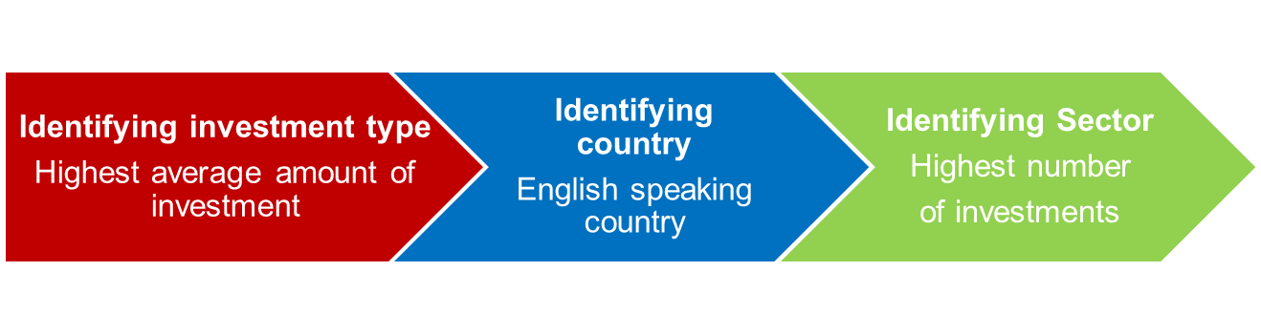
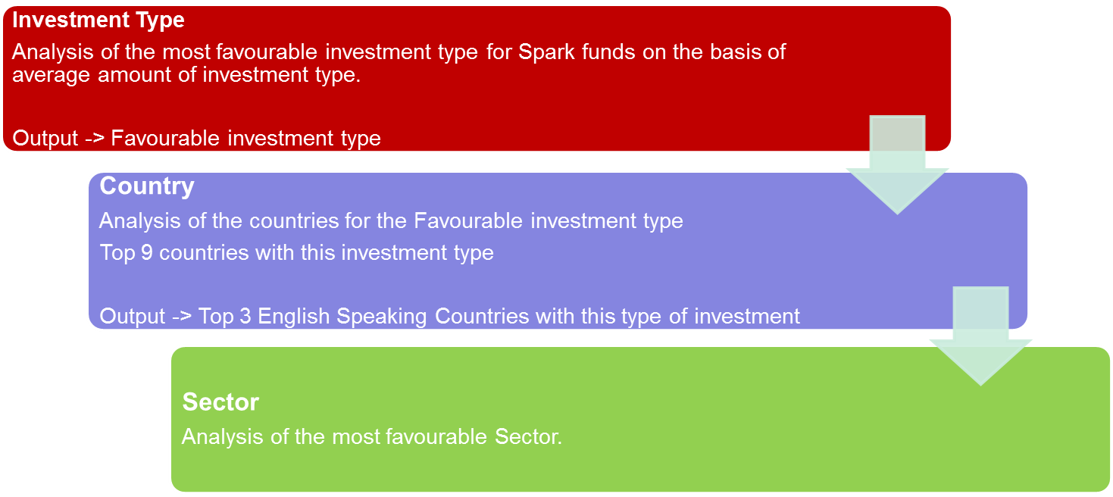
Problem Solving

Slide 4
Analysis – Investment type
Identify Average Investment for each funding type.
Identify Investment Type with average amount between 5 to 15 million USD.
Assumption: Companies for which raised amount data was missing were ignored.
Conclusion: Recommendation: “Venture” Investment Type

Slide 5
Analysis – Country
Identify countries for recommended investment type.
Identify total amount invested for each country with recommended investment type.
Identify Top 9 countries for recommended investment type with highest investment.
Identify Top 3 English speaking countries
Assumption: Companies with no country codes were ignored.
Reference for Country codes taken as per ISO Code 3 convention.
Conclusion: Recommended Countries - United States, Great Britain and India

Slide 6
Analysis - Sector
Identify number of investments for each sector for recommended countries and investment type.
Identify Top 3 sectors with highest number of investments for each recommended country and recommended investment type.
Assumption: Companies for which raised amount data was missing were ignored.
Conclusion:
GBR | IND | USA
Others | Others | Others
Cleantech / Semiconductors | News, Search and Messaging | Cleantech / Semiconductors
Social, Finance, Analytics, Advertising | Social, Finance, Analytics, Advertising | Social, Finance, Analytics, Advertising

Slide 7
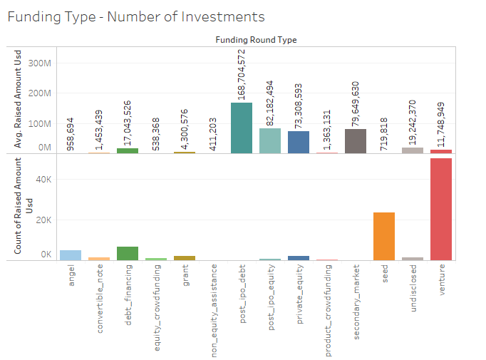
Investment Type
“Venture” Investment Type is the
recommended investment type.

Slide 8
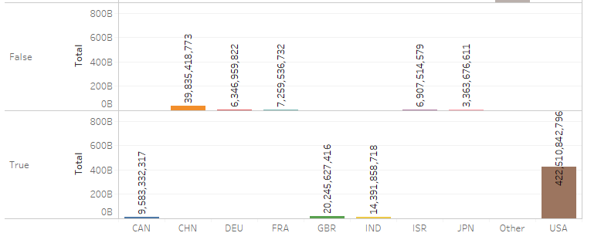
Country
USA, Great Britain and India are
recommended for “venture” investment type.

Slide 9
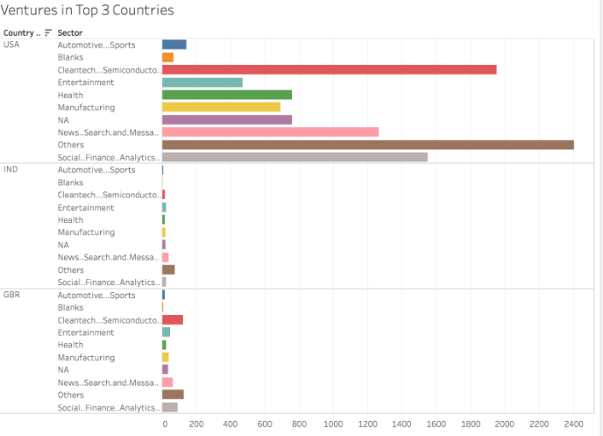
Sector
Sectors identified for each recommended
country

Slide 10
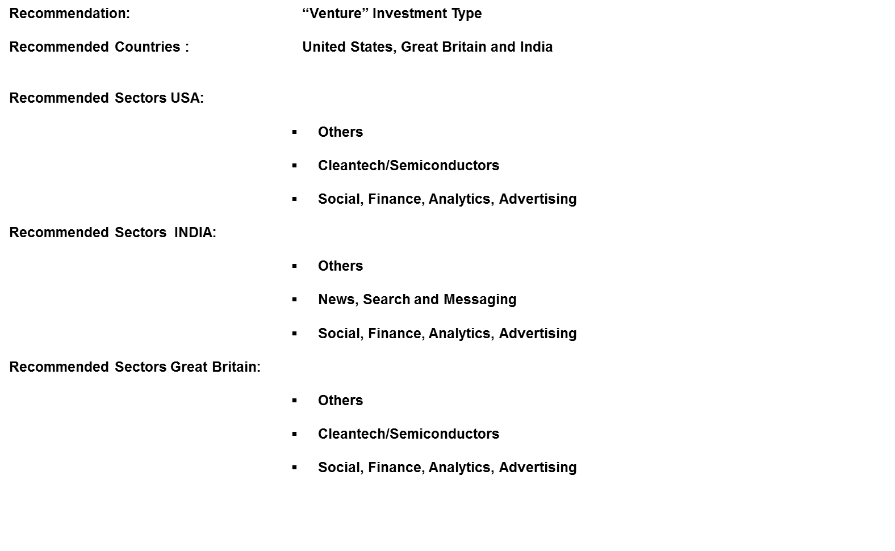
Conclusion

